Slide 1
Random Variables and Probability Distributions

Slide 2
Joint Probability Distributions

Slide 3
Joint Probability Distributions
If X and Y are two discrete random variables, the probability distribution for their simultaneous occurrence can be represented by a function with values f(x, y) for any pair of values (x, y) within the range of the random variables X and Y .
It is customary to refer to this function as the joint probability distribution of X and Y .
Hence, in the discrete case,
f(x, y) = P(X = x, Y = y);

Slide 4
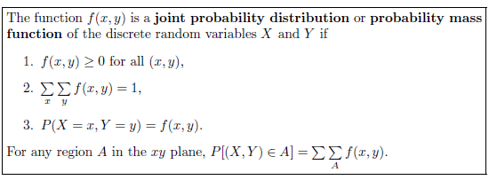
Joint Probability Distributions

Slide 5

Example: Two ballpoint pens are selected at random from a box that contains 3 blue pens, 2 red pens, and 3 green pens. If X is the number of blue pens selected and Y is the number of red pens selected, find
(a) the joint probability function f(x, y),
(b) P[(X, Y ) ∈ A], where A is the region {(x, y)|x + y ≤ 1}.
Solution: a)

Slide 6
(a) the joint probability function f(x, y),

Slide 7
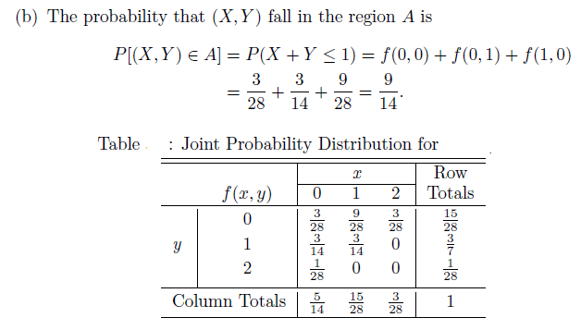
(b) P[(X, Y ) ∈ A], where A is the region {(x, y)|x + y ≤ 1}.
Solution:

Slide 8
Marginal Distribution

Slide 9

Marginal Distribution
Given the joint probability distribution f(x, y) of the discrete random variables X and Y , the probability distribution g(x) of X alone is obtained by summing f(x, y) over the values of Y . Similarly, the probability distribution h(y) of Y alone is obtained by summing f(x, y) over the values of X. We define g(x) and h(y) to be the marginal distributions of X and Y , respectively.

Slide 10
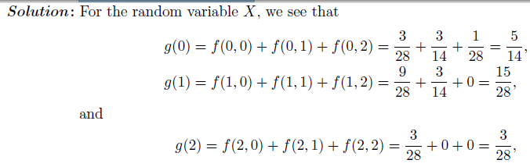
Marginal Distribution
Example: Show that the column and row totals of Table given below, give the marginal distribution of X alone and of Y alone.

Slide 11

which are just the column totals of Table. In a similar manner we could show that the values of h(y) are given by the row totals. In tabular form, these marginal distributions may be written as follows:

Slide 12
Statistically independent

Slide 13
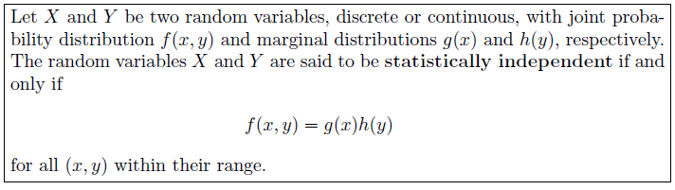
Statistically independent

Slide 14
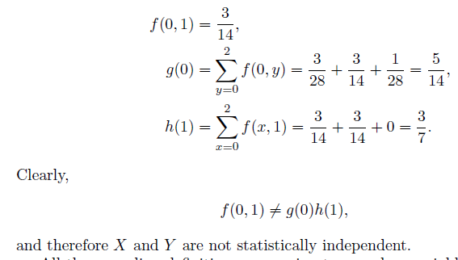
Example: Show that the random variables of previous example are not statistically independent.
Solution: Let us consider the point (0, 1). We find the three probabilities f(0, 1), g(0), and h(1) to be

Slide 15
Assignment Questions
3.39
3.48
3.49
3.50
3.51
3.54
3.55

